Slide 1
PCA & CLUSTERING ASSIGNMENT SUBMISSION
Name:
Dinesh Challa

Slide 2
Help International Country Analysis
Help International would like to know the countries in dire need of aid to spend the $ 10 million fund strategically and effectively.
This can be achieved by the means of clustering. Two clustering algorithms have been used
K-means Clustering
Hierarchical Clustering
Business objective: The objective is to identify 5 countries which are in dire need of aid so that Help International can wisely distribute it’s fund.
Goals of data analysis: The two main goals of the analysis is to:
Cluster countries using K-means and Hierarchical Clustering.
Analyse and identify the clusters that need help and report 5 countries.

Slide 3
Problem solving methodology
Import loan dataset and understand data in hand
Hierarchical Clustering
Analyze & Visualize clusters
Data Cleaning (Outlier Treatment)
Data Preparation & Standardization
Determine countries
Report 5 Countries
PCA (Dimensionality Reduction) & Hopkins statistic
Analyze & Visualize clusters
K-means Clustering
Silhouette Score & Elbow Curve (K=3)

Slide 4
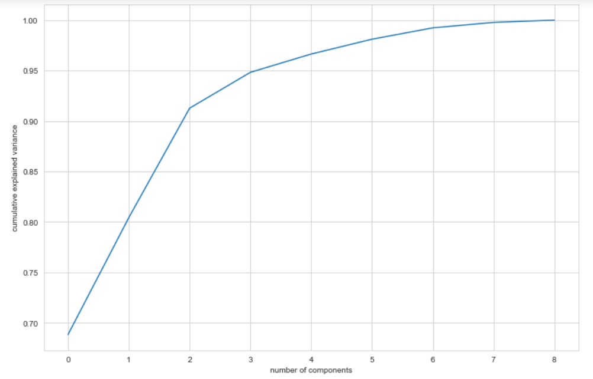
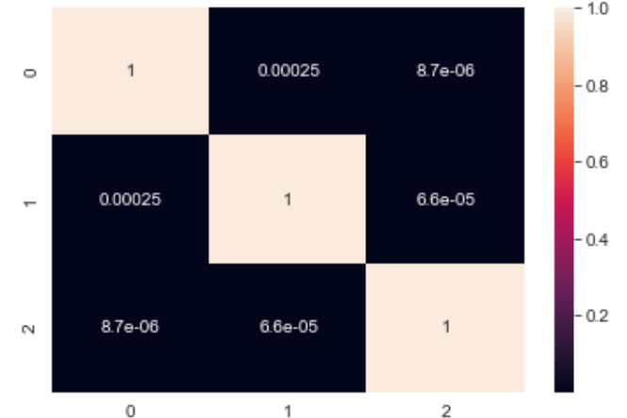
Principal Component Analysis
PCA has been performed on the scaled data frame and Scree plot has been plotted. The first 3 principal component explained around 95% of variance. So, the number of principal components where chosen as 3.
Correlation matrix of Principal Components
Scree Plot

Slide 5
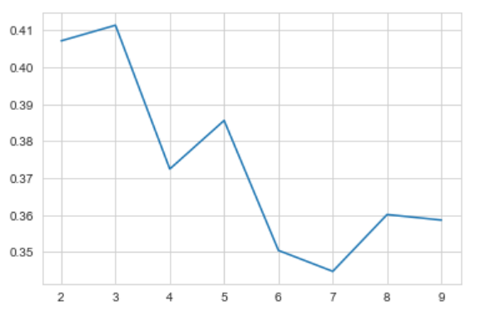
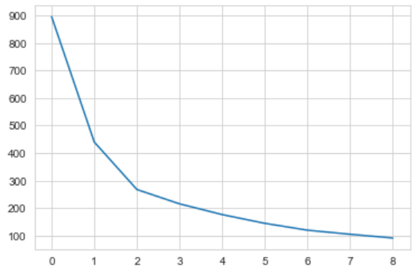
Hopkins Statistic, Silhouette Score & Elbow Curve
Hopkins Statistic is >0.5. Thus, the dataset has tendency to form clusters. The silhouette score analysis suggests 3 clusters and Elbow curve suggests two clusters.
Sum of Squares
No. of Clusters
No. of Clusters
Silhouette Score Analysis
Elbow Curve
On performing K-means clustering using 2 & 3, a better clustering happened at K=3.

Slide 6
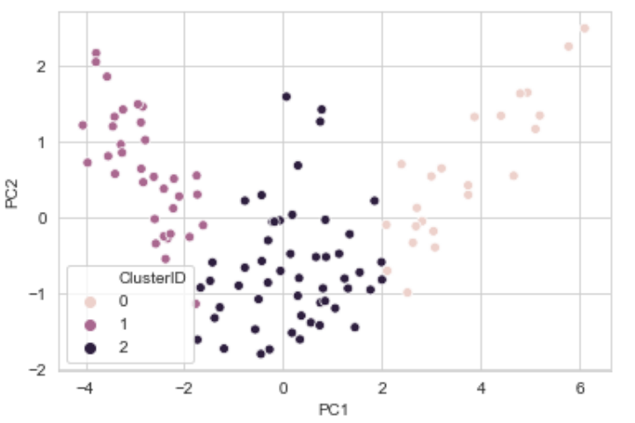
K-means Clustering (K = 3)
The scatter plot shows the principal components clustered at left, right and center.
Scatter Plot of Principal Components over Cluster ID

Slide 7
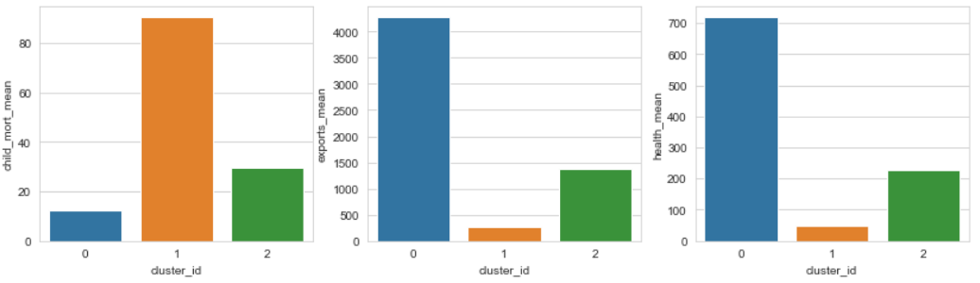
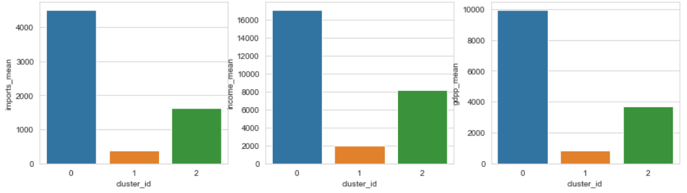
Mean is calculated for some original attribute over the Cluster ID and plots are made. It is observed that for Cluster 1, the bar plots show:
High Child Mort
Low exports
Low imports
Low income
Low GDPP
Low Health
After analyzing all the attributes, we can say that Cluster 1 is our area of interest.

Slide 8
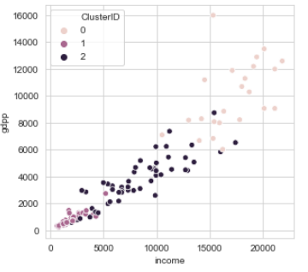
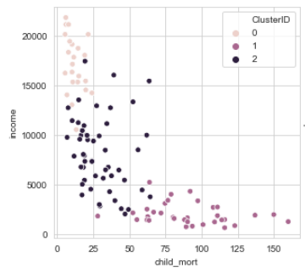
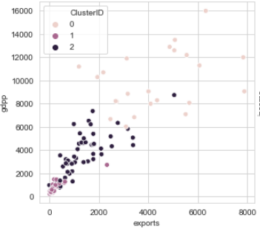
The following graphs have been plotted against original variables:
Income vs GDPP
Child mortality vs Income
Exports vs GDPP
From the above graphs we can identify some logical clusters happening. The countries identified by K-means clustering are summarized in the last slide.

Slide 9
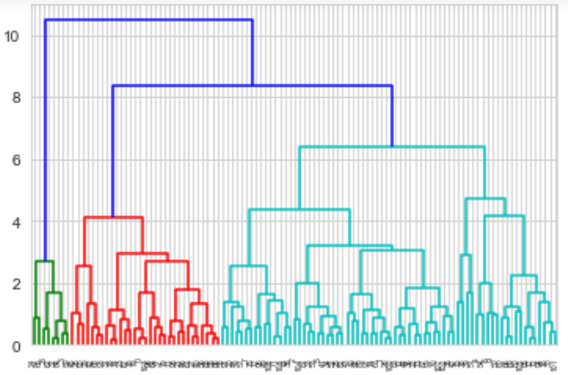
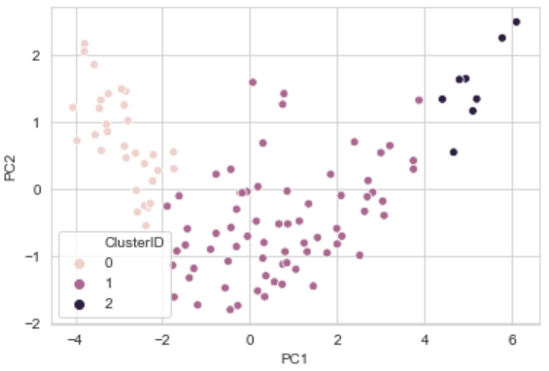
Hierarchical Clustering( Number of Clusters = 3)
Dendrogram obtained after performing Hierarchical Clustering
Scatter Plot of Principal Components over Cluster ID
We can identify 3 differentiable clusters in the above Dendrogram. So, let’s assume our number of cluster to be 3.

Slide 10
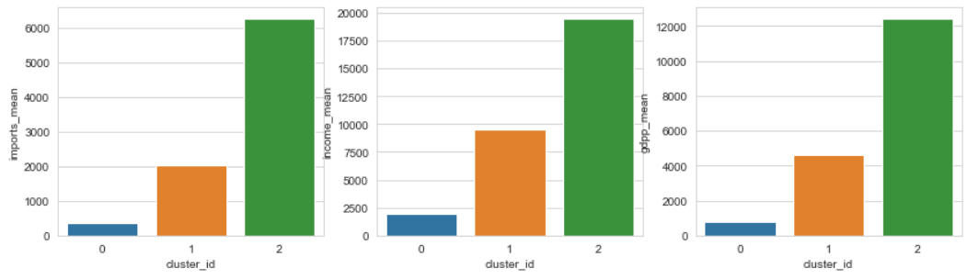
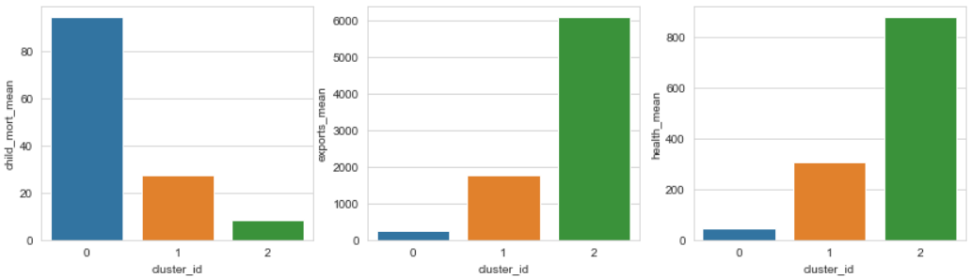
Mean is calculated for some original attribute over the Cluster ID and plots are made. It is observed that for Cluster 0, the bar plots show:
High Child Mort
Low exports
Low imports
Low income
Low GDPP
Low Health
After analyzing all the attributes, we can say that Cluster 0 is our area of interest.

Slide 11
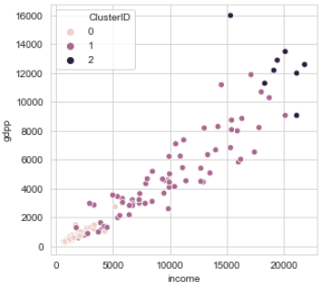
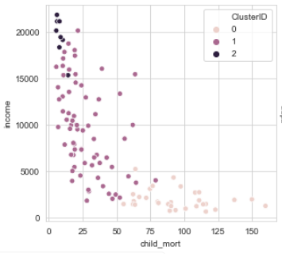
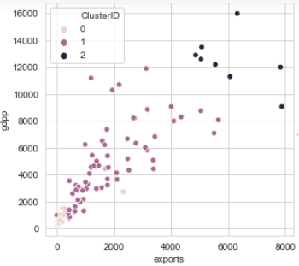
The following graphs have been plotted against original variables:
Income vs GDPP
Child Mortality vs Income
Exports vs GDPP
From the above graphs we can identify logical clusters happening. The countries identified by hierarchical clustering are summarized in the last slide.

Slide 12
Conclusions
The countries in dire need are obtained by using the concept of binning wherein the aggregate mean value of attributes which define the variance of the desired cluster are determined. Binning is performed on the original data frame based on these aggregate values.
The countries obtained after binning were then sorted in the descending order of child mortality as it is a byproduct of poverty and lack of basic amenities such as healthcare etc. The top 5 countries which are commonly seen using both the clustering algorithms are reported to Help International.
Both K-means and Hierarchical clustering had the same countries in the top 5. Hence, the 5 countries in need of aid are:
Central African Republic
Mali
Niger
Burkina Faso
Congo, Dem. Rep.

